Slide 1
Performance Gap
Progress Report
Ying He
21 June

Slide 2
Tasks
Create building models
Compare Standardized model and detailed dynamic models
Evaluate sources of modelling errors
Find out limitations of the standardized method
Identify the important parameters in modelling

Slide 3
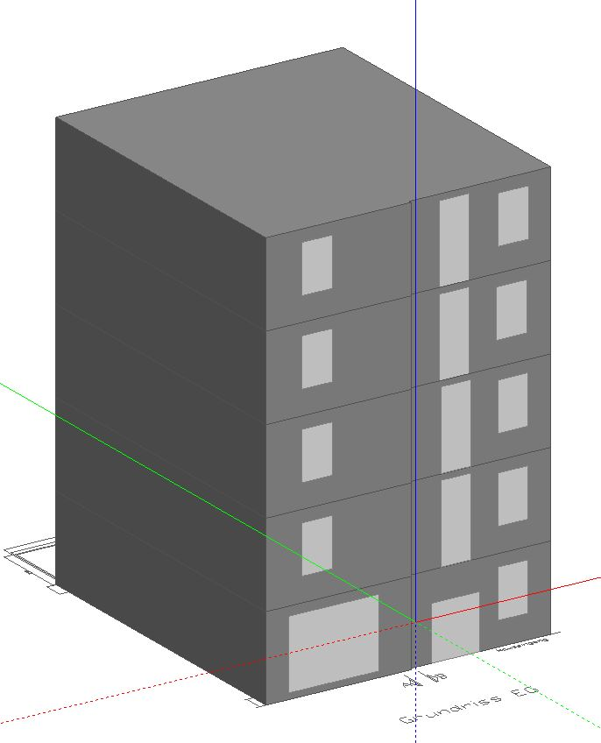
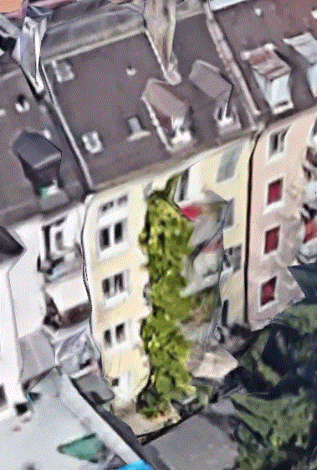
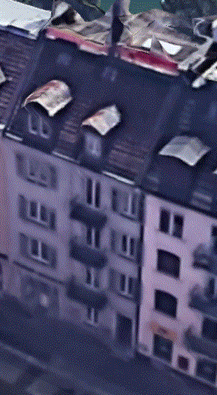
DesignBuilder Model
Honggerstrasse Residential Building

Slide 4
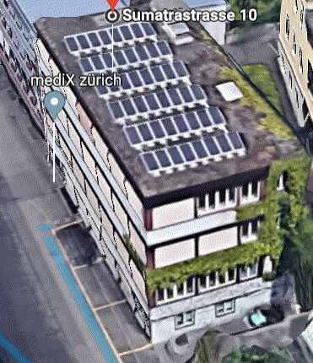
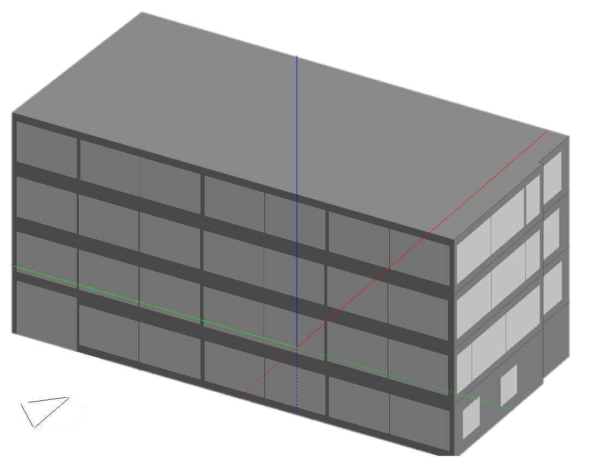
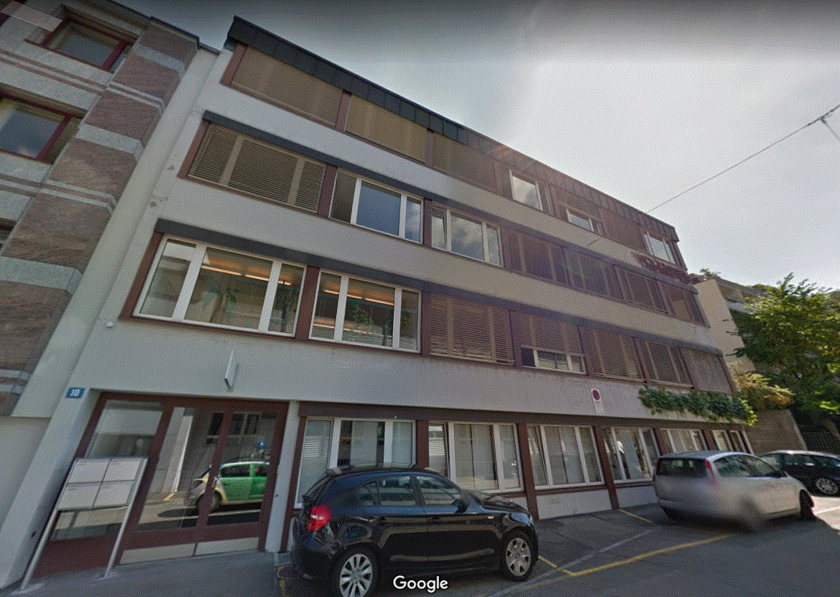
DesignBuilder Model
Sumatrastrasse Office Building

Slide 5
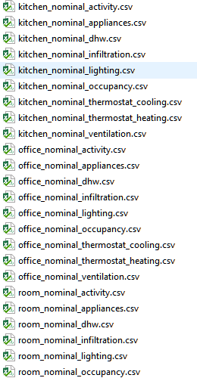
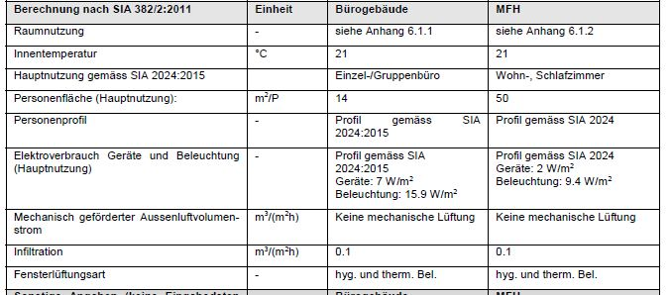
Norminal (Standardized) Analysis - EnergyPlus
SIA 2024 Building Schedule
SIA 382 Standardize building assumption

Slide 6
Nominal Analysis Result
EnergyPlus heating energy demand much lower than the real measurement
Building | Real/Measurement Heating Demand (2015) (kWh/m2) | Calculated Heating Demand from EnergyPlus (kWh/m2) | % of calculated value to real heating demand
Sumatrastr. Office | 70 | 50.87 | 73%
Honggerstr. Residential | 62 | 36.22 | 60%

Slide 7
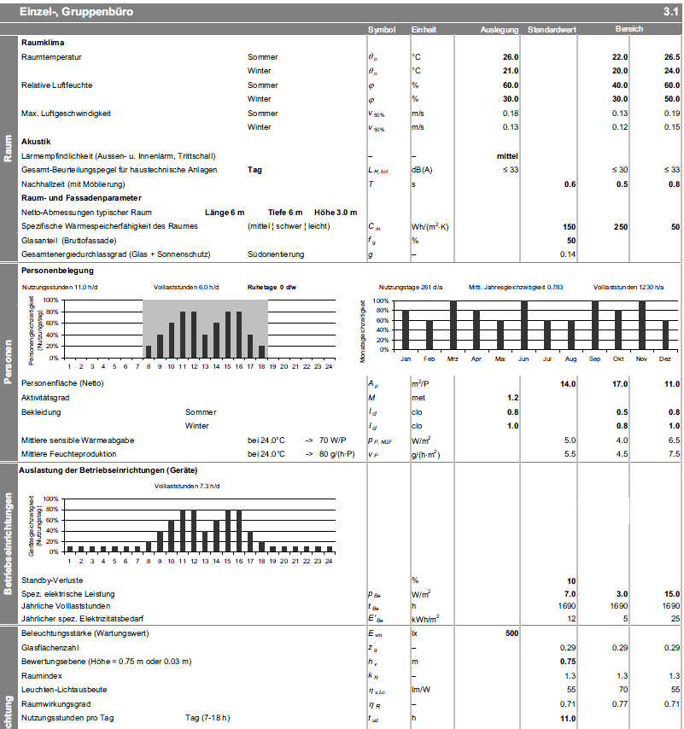
Dynamic Analysis – jE-Plus
Random generated parameters
Variable occupancy for different floors and zones (discrete)
Triangle distribution for heating, cooling, electricity, and lighting levels
Normal distribution for ventilation level
1000 jobs in total

Slide 8
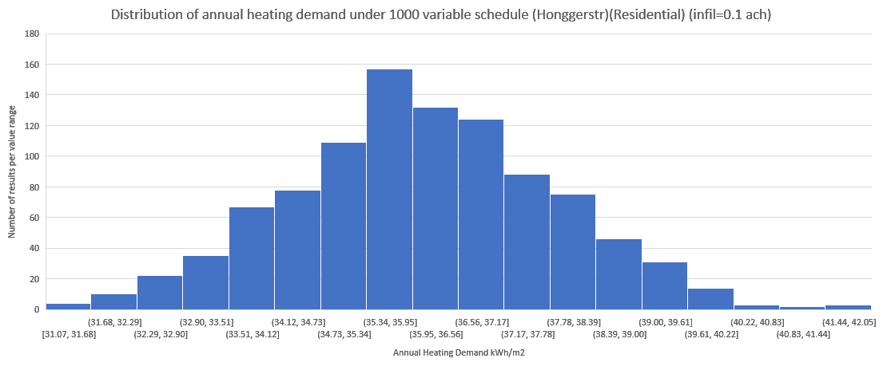
Honggerstr. Residential building results
Range between 31.07 to 42.05, lower than the measured heating demand

Slide 9
Possible Reasons
Too low air infiltration (0.1)
Outdoor temperature limitation (default 0 degree)
Too low occupancy (average ~0.5 person per zone)
No window shading control
Too few time step
A time step = 6 can obtain a higher heating demand than time step = 2 (origin)
Roughness parameter of insulation material
Energy demand would obtain a higher value when insulation material has smooth surface
Different Weather Condition in 2015

Slide 10
Heating demand with different air infiltration

Slide 11
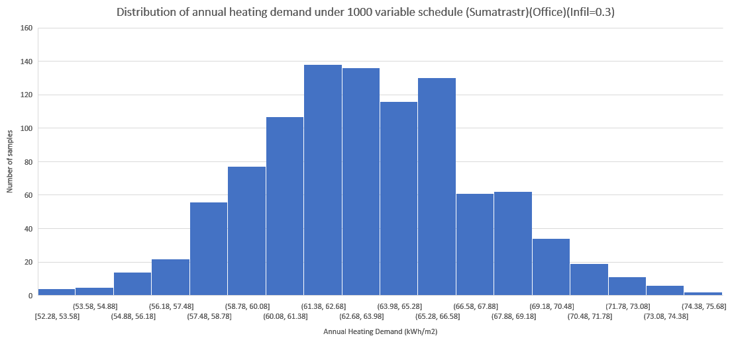
Variable results with different infiltration (Sumatrastr)
Median: 63.39
Average: 63.54
> 70: 4.5%

Slide 12
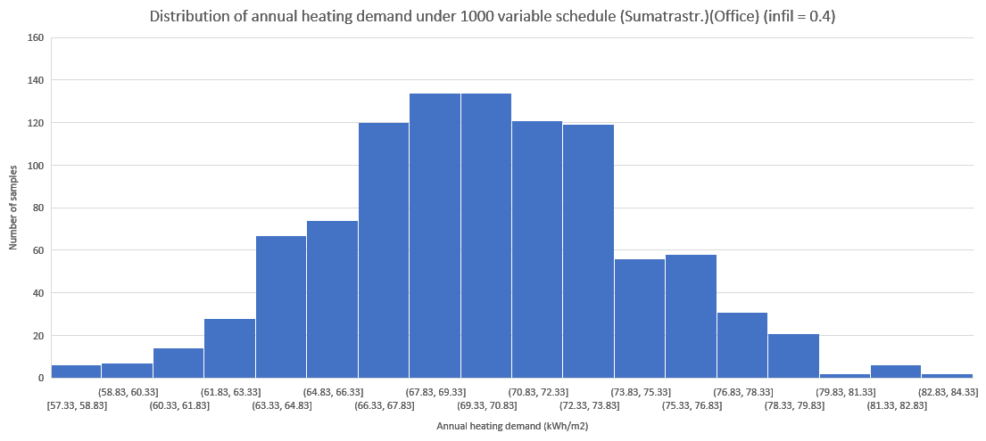
Variable results with different infiltration (Sumatrastr)
Median: 69.82
Average: 69.98
> 70 : 48.2%

Slide 13
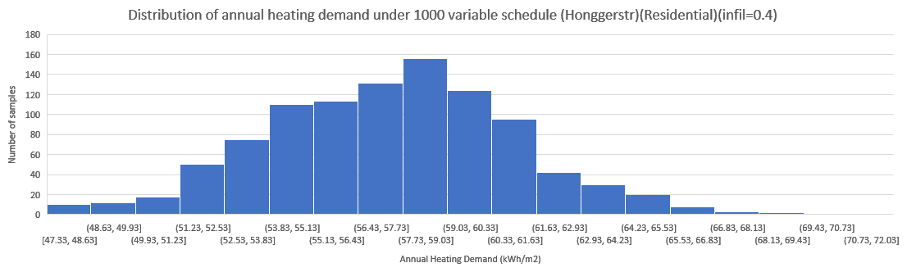
Variable results with different infiltration (Hongg)
Infiltration | Minimum heating demand (kWh/m2) | Nominal heating demand (kWh/m2) | Maximum heating demand (kWh/m2)
0.1 (standard) | 32.46 | 31.07 | 42.05
0.2 | 36.3 | 43.11 | 50.6
0.3 | 40.3 | 50.19 | 60.3
0.4 | 47.33 | 57.41 | 72.03
Median:57.46
Average:57.39
> 62 : 9.1%

Slide 14
Annual Heating demand with different air infiltration & correct outdoor air temperature limitation (Hongger)
Air Infiltration | with outdoor air correction (kWh/m2) | without correction (kwh/m2)
0.1 (Standard) | 40.3 | 36.22
0.2 | 47.2 | 43.11
0.3 | 54.29 | 50.19
0.4 | 61.51 | 57.41
Measured value (2015) | 62 | 62
*Time step: 6
*Roughness of insulation material: smooth

Slide 15
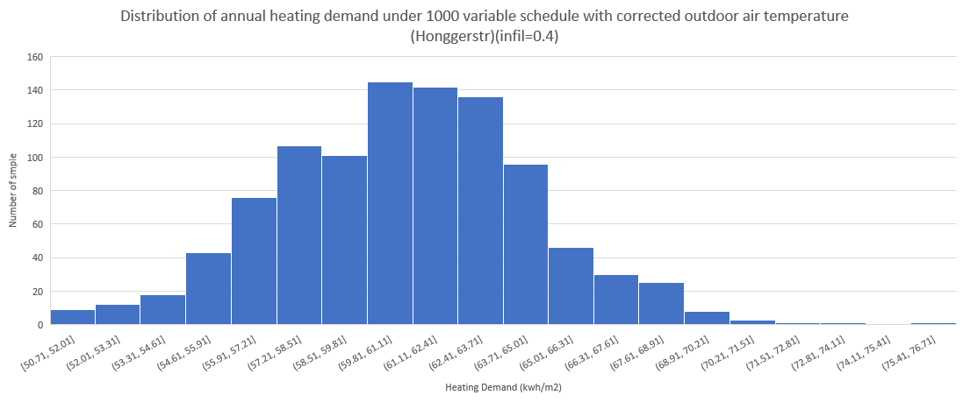
Dynamic Analysis with Corrected outdoor air (Hongg)
Median: 61
Average: 60.95
> 62 : 40.4%

Slide 16
Next Step
Redo the simulations in 2015 Zurich Weather file
Replace the RH,wetbulb and drybulb temperature, wind speed with 2015 data
Review the building model/schedules

